Slide 1
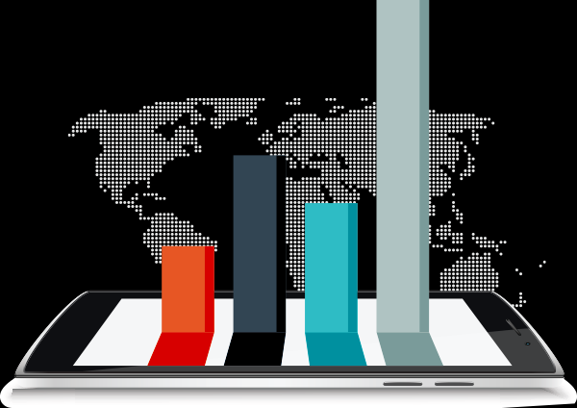
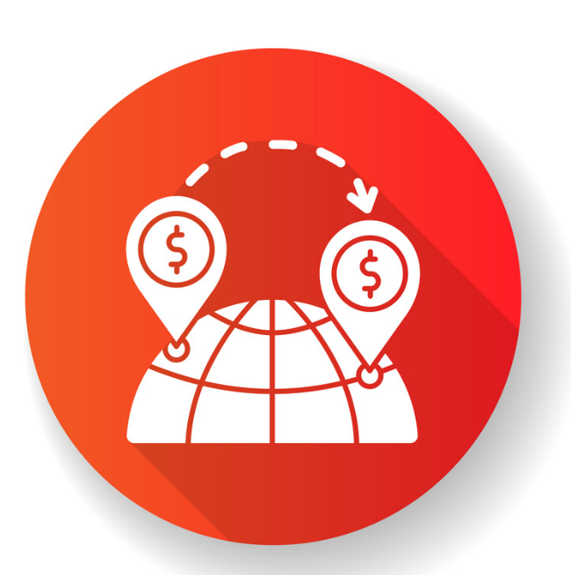
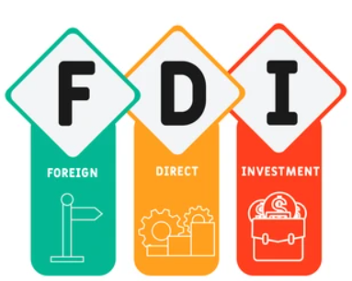

INVESTMENT ANALYTICS
BY SARTHAK TYAGI

Slide 2
INVESTMENT ANALYTICS
Objective: The objective of this project is to develop a dashboard that provides a detail analysis on foreign direct investment coming to India during 2000-01 to 2016-17
Methodology: The dashboard has been developed using Power BI. The project uses data from the Kaggle data repository to populate the dashboard.
Features: The dashboard includes several features that allow users to interact with the data and analyze it in different ways. These features include:
Year on Year Growth Analysis.
Total FDI till 2014.
Total FDI after 2014.
Top sectors.
Total FDI per Year.

Slide 3
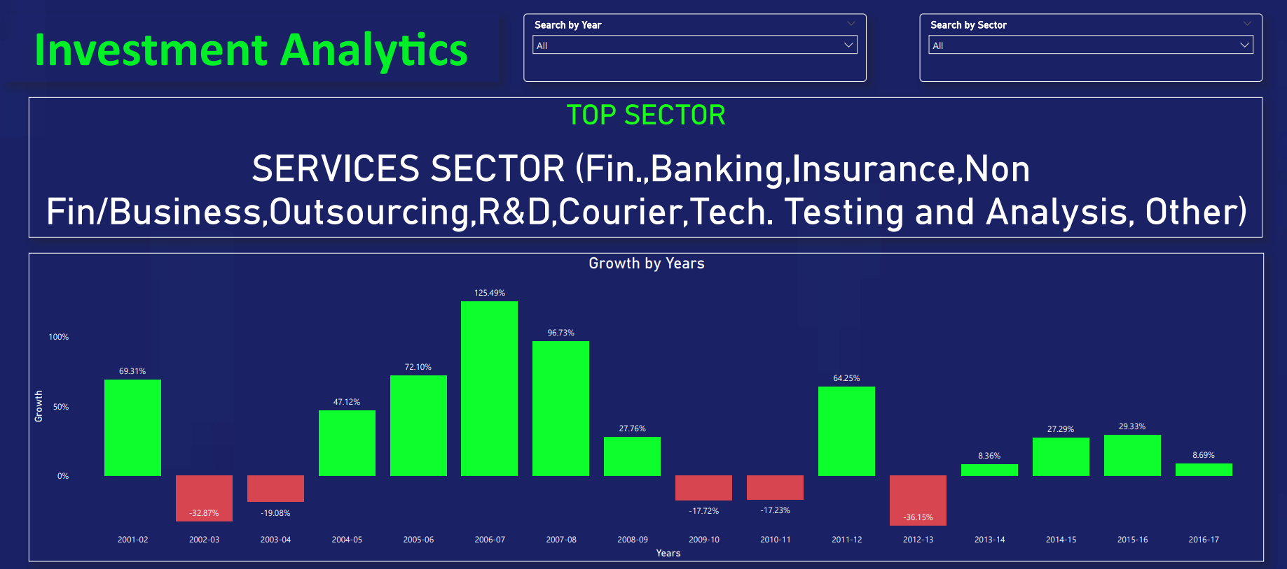
Slide 3
1
This section concludes that during 2004-05 to 2008-09 India witnessed a high inflow of foreign direct investment.

Slide 4
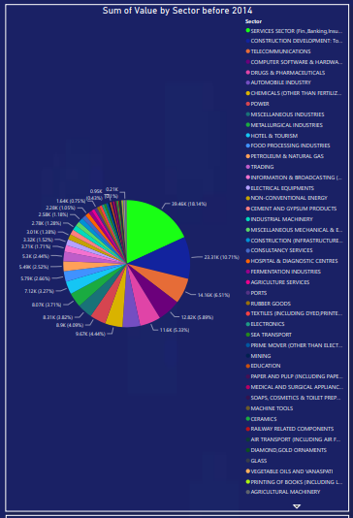
Slide 3
2
In this section, I analyzed the Fdi trend before 2014.
We can conclude that FDI is highest in Service sector during this phase.

Slide 5
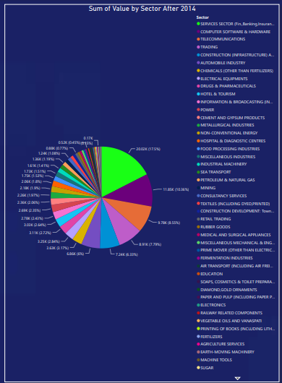
Slide 3
3
In this section, I analyzed the Fdi trend after 2014.
We can conclude that FDI is highest in Service sector during this phase also.

Slide 6
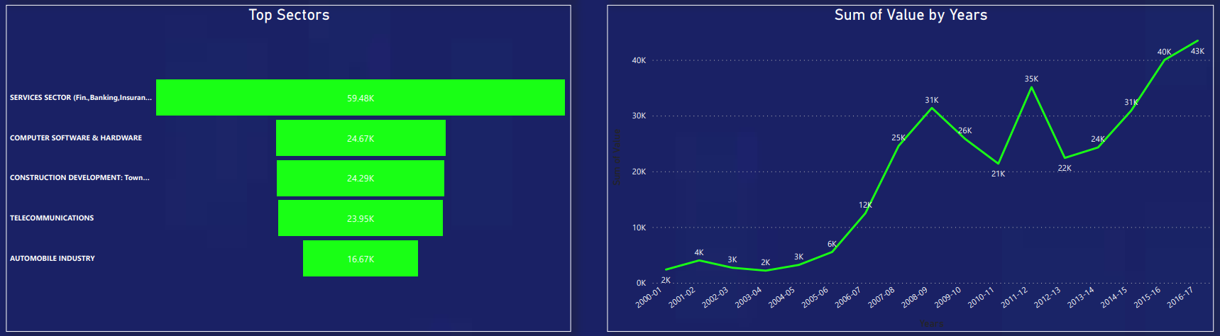
Slide 3
4
In this section, I tried to find the overall top sectors & Year.
We can further conclude that the service sector fetch the highest fdi overall and the year 2016-17 is the year in which FDI is maximum.

Slide 7
Conclusion
The Investment Analytics Dashboard offers users a comprehensive overview of FDI inflow in India from 2000-01 to 2016-17, enabling data analysis from various perspectives. With its interactive and user-friendly interface, the dashboard serves as an invaluable tool for researchers, policymakers, and the general public alike.
This dashboard exemplifies the effective utilization of technology in tracking and analyzing growth trends. It provides valuable insights into FDI distribution across different sectors. To enhance the project further, it is recommended to incorporate additional data sources and expand the dashboard's features.
In conclusion, this project represents a dedicated effort to employ data analytics for monitoring and providing insights into FDI inflow. The Investment Analytics Dashboard offers an accessible and interactive platform, equipping users with vital information on FDI and establishing itself as an invaluable resource for anyone interested in monitoring growth trends.

Slide 8
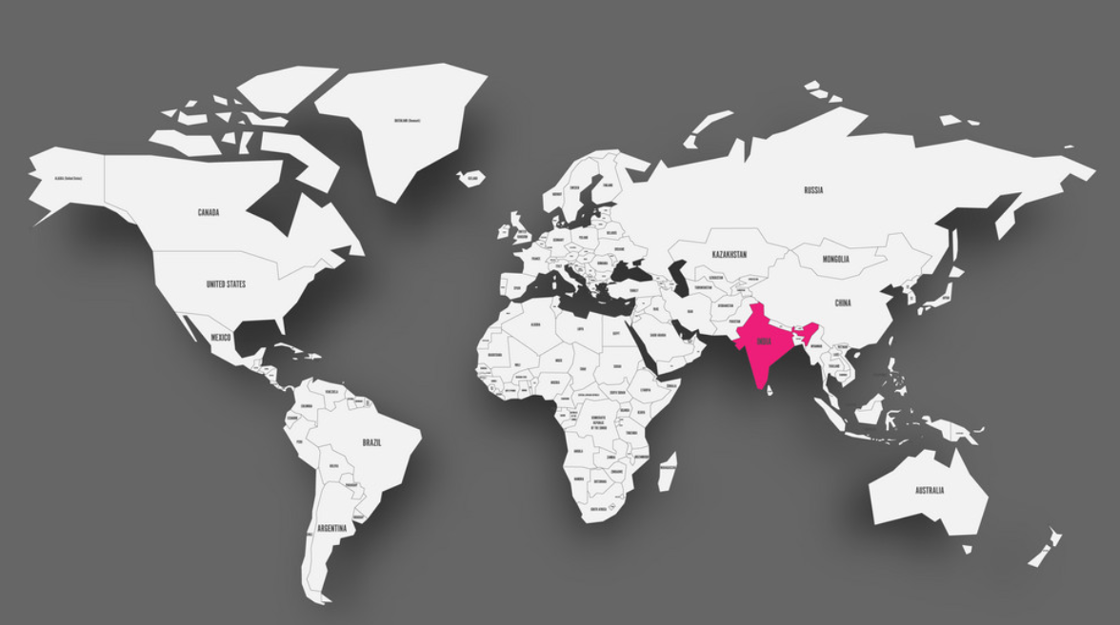
Research Presentation End
BY SARTHAK TYAGI
Notes:
You can use this slide as your opening or closing slide. Should you choose to use it as a closing, make sure you review the main points of your presentation. One creative way to do that is by adding animations to the various graphics on a slide. This slide has 4 different graphics, and, when you view the slideshow, you will see that you can click to reveal the next graphic. Similarly, as you review the main topics in your presentation, you may want each point to show up when you are addressing that topic.
Add animation to images and graphics:
Select your image or graphic.
Click on the Animations tab.
Choose from the options. The animation for this slide is “Split”. The drop-down menu in the Animation section gives even more animations you can use.
If you have multiple graphics or images, you will see a number appear next to it that notes the order of the animations.
Note: You will want to choose the animations carefully. You do not want to make your audience dizzy from your presentation.

